Slide 1
Flexibility and Maintainability
And their metrics:
coupling and cohesion
CS
Henrik Bærbak Christensen

Slide 2
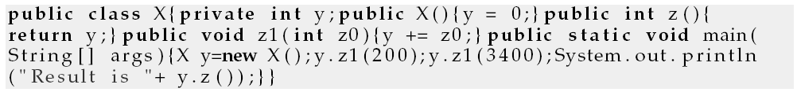
What is this?
So – all you smart guys and girls – what is this?
What does it do?
What every-day abstraction is this code implementing?
(Note: the code fragment in the book is incorrect ☹)
CS
Henrik Bærbak Christensen

Slide 3
The point
The customers / executing software do not care if the code is
  Readable / understandable / well documented
As long as it serves its purpose well...
However, developers do
  Unless you are about to quit tomorrow
  Or in a consulting company ☺
CS
Henrik Bærbak Christensen

Slide 4
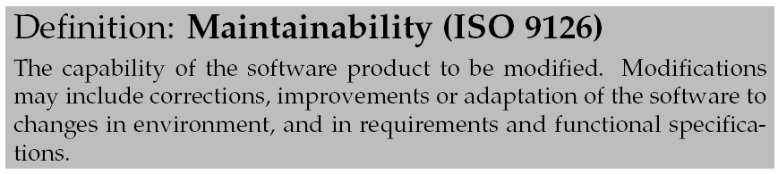
What developers want...
We need software to be maintainable
Maintainability is a quality that our code has to a varying degree
  Low maintainability -> high maintainability
CS
Henrik Bærbak Christensen

Slide 5
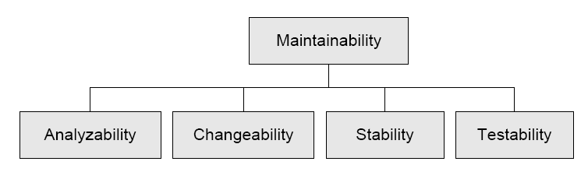
Aspects
Maintainability is influenced by a lot of sub qualities.
CS
Henrik Bærbak Christensen

Slide 6
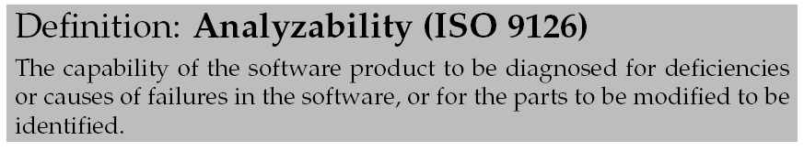
Analyzability
Basically: can I understand the code?
  Indentation
  Naming conventions for classes/methods
  Useful comments and JavaDoc
  Training!
    To spot e.g. Design Patterns
CS
Henrik Bærbak Christensen

Slide 7
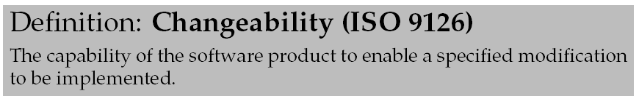
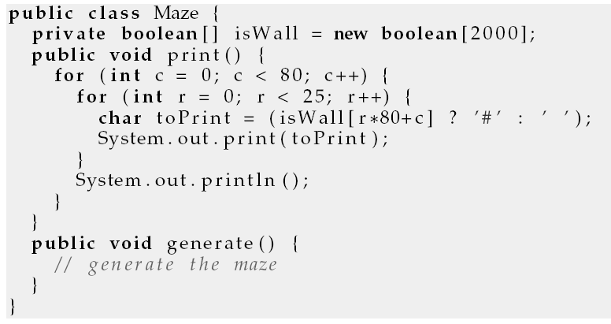
Changeability
Cost of modifying the code
  160x45 maze?
CS
Henrik Bærbak Christensen

Slide 8
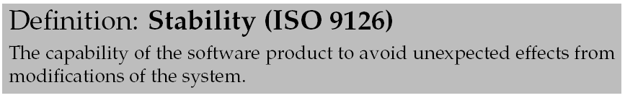
Stability
In BASIC all variables are global
  do not store some global property in variable i !
    Why not?
CS
Henrik Bærbak Christensen

Slide 9
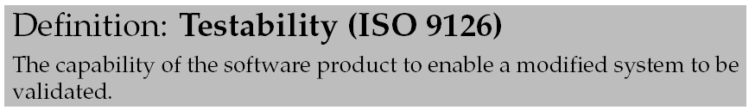
Testability
Everything can be tested – right?
Ariane rocket guidence system bug
  Found when they launched it...
CS
Henrik Bærbak Christensen

Slide 10
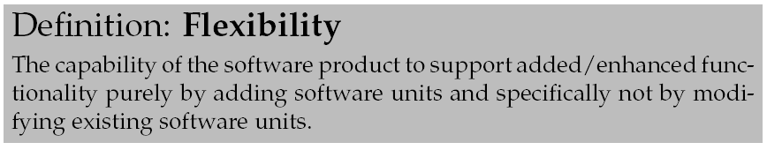
Flexibility
A main theme of FRS !
Change by addition, not by modification...
CS
Henrik Bærbak Christensen

Slide 11
Coupling and Cohesion
Two metrics highly correlating to maintainability of software
CS
Henrik Bærbak Christensen

Slide 12
To measure software
Programmers with some experience has a sense of good and bad software.
Some of the ”heavy guys” like Kent Beck and Martin Fowler also talks about code smell.
But... what is good and what is bad?
Not very scientific anyway ☺
It is better to measure software according to some defined metric.
CS
Henrik Bærbak Christensen

Slide 13
Examples of metrics
A very simple, widely used, and next to useless metric is kloc = Kilo Lines of Code. It simply measures the quantity of code.
Useless?
  Is 2kloc better than 1kloc?
CS
Henrik Bærbak Christensen

Slide 14
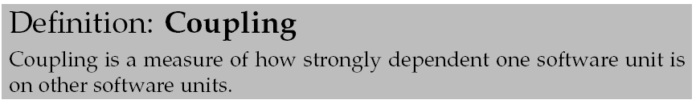
A maintainability measure
Coupling (da: kobling):
unit = a well delimited unit of code: class, package, module, method, application, etc.
Low coupling: few dependencies
Tight coupling: lot of dependencies
CS
Henrik Bærbak Christensen

Slide 15
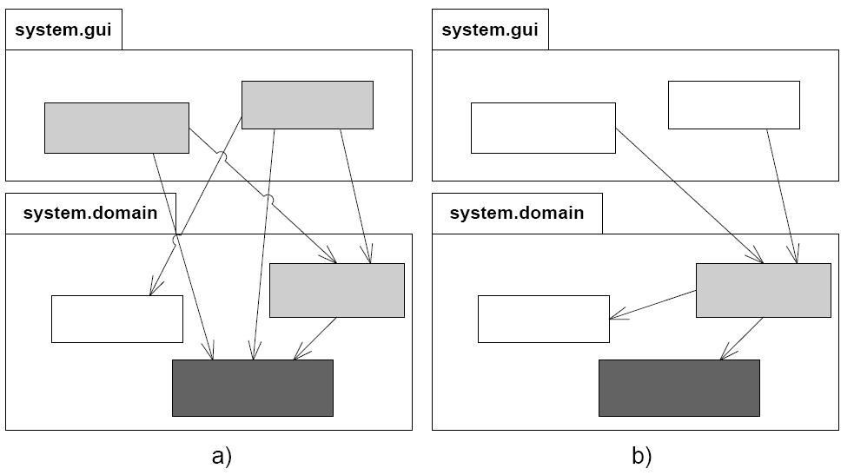
Example
CS
Henrik Bærbak Christensen

Slide 16
Exercise
Name some language constructs or techniques that generate dependencies between two classes.
?
CS
Henrik Bærbak Christensen
Notes:
objec references
global access to variables
database access
method calls
formats on Data
interpretations on data

Slide 17
War story
In the ABC research project, a knowledge based system was able to guess at human activities based on knowledge of location of objects in a hospital setting.
For instance co-location of a medicine tray, a nurse and a patient would trigger a ”the patient is receiving medicine” activity proposal.
The ID used in the knowledgebase was RFID tag ID.
Later, some programmer changed ID for persons to CPR identity instead ☺.
CS
Henrik Bærbak Christensen

Slide 18
Rule of Thumb:
Not that surprising:
Assign responsibility so coupling is low
Because
  Local change has no/less impact
  Easier to understand modules in isolation
  Higher probability of reuse with few dependencies
CS
Henrik Bærbak Christensen

Slide 19
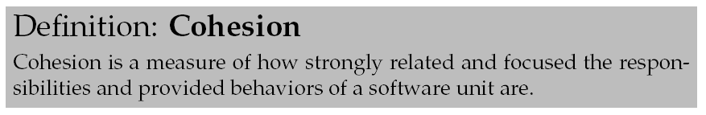
Cohesion
Cohesion (da: kohæsion/binding/samhørighed):
Example:
  Unit X: all classes that begin with letters A, B, and C
  Unit Y: all classes related to booking a flight seat
CS
Henrik Bærbak Christensen

Slide 20
Rule of Thumb
Also not surprising:
Assign responsibility so cohesion is high
CS
Henrik Bærbak Christensen

Slide 21
Discussion
Maintainable software generally has weak coupling and high cohesion.
Weak coupling means one change does not influence all other parts of the software
  lowering cost of change
High cohesion means that a change is likely localized in a single subsystem, easier to spot
  lowing the cost of change
CS
Henrik Bærbak Christensen

Slide 22
Law of Demeter
A very concrete “law” that addresses the coupling measure is Law of Demeter:
Do not collaborate with indirect objects
Also known as
Don’t Talk to Strangers
Example
p.getX().getY().getZ().fecthA().doSomething();
CS
Henrik Bærbak Christensen

Slide 23
Lieberherr
Within a method, messages should only be sent to
  this
  a parameter of the method
  an attribute of this
  an element of a collection which is an attribute of this
  an object created within the method
In other words: “never two dot’s in a call” ☺
CS
Henrik Bærbak Christensen

Slide 24
War story
Major Danish IT company
  problem: dynamic configuration of user interface elements
  solution:
    configuration parameters in property file
    read at run-time
    if ( dialogX.panelY.listboxZ.color == NONE ) { ...}
  ☹
CS
Henrik Bærbak Christensen

Slide 25
Then what?
Rule of Thumb:
  Assign the responsibility to the client’s direct object to do the collaboration with indirect objects
Thus
  order.getItem(3).getPrice().addTax()
  should be replaced by
  order.addTaxToItem(3);
Liabilities?
CS
Henrik Bærbak Christensen

Slide 26
Then what?
Exercise:
  Do we see this in the pay station?
  In HotGammon/HotCiv?
Consequences
  ☺ Law of Demeter lowers direct coupling
  ☹ Interfaces may bloat with too many method
CS
Henrik Bærbak Christensen

